Slide 1
John von Neumann
The Kosygin State University of Russia
Nikita Olkhovsky ITA-123 group
Moscow 2025

Slide 2
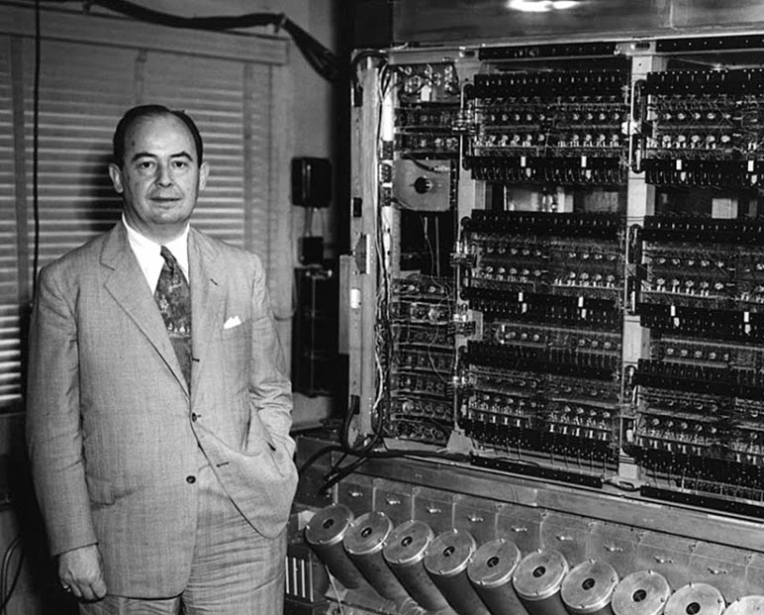
The Architect of Modern Computing
John von Neumann
Born in 1903 in Hungary
Made groundbreaking contributions to mathematics, physics, and economics
The creator of the von Neumann architecture

Slide 3
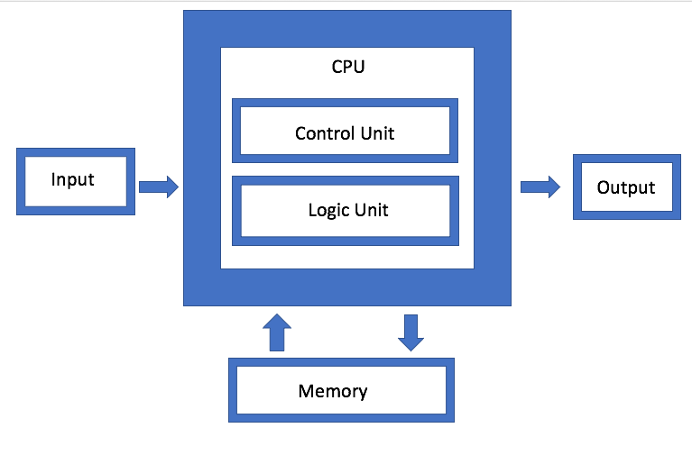
The Von Neumann Architecture
Revolutionary concept: a computer with a stored-program architecture.
Key components:
Memory
Central Processing Unit (CPU)
Input/Output (I/O) devices

Slide 4

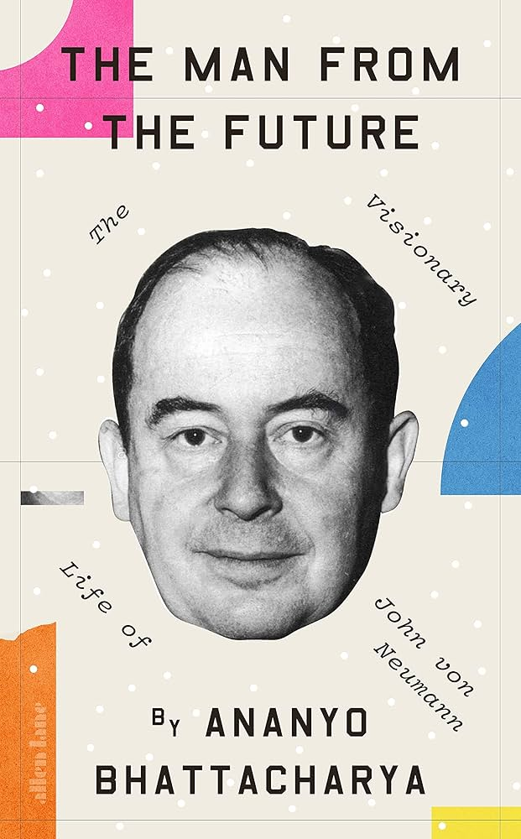
Impact on Modern IT
Computers became easy to reprogram, which led to the creation of software as we know it today.
Influenced artificial intelligence, cybersecurity, and complex simulations

Slide 5
Words to memorize
visionary – провидец/предсказатель
prodigy – вундеркинд/юный талант
Incredible – невероятный
contributions – вклад
Influence – влияние
powers computers – используется в компьютерах
Inflexible – негибкий
manual – ручной
control unit – блок управления
blueprint – чертёж
artificial – искусственный
trace back to – восходят к/заложены

